Slide 1
Functions
f( ) =
A
B

Slide 2
This Lecture
We will define a function formally, and then
in the next lecture we will use this concept in counting.
We will also study the pigeonhole principle and its applications.
Examples and definitions (injection, surjection, bijection)
Pigeonhole principle and applications

Slide 3
Functions
Informally, a function f “maps” the element of an input set A
to the elements of an output set B.
More formally, we write
to represent that f is a function from set A to set B, which
associates an element with an element
The domain (input) of f is A.
The codomain (output) of f is B.
Definition: For every input there is exactly one output.

Slide 4
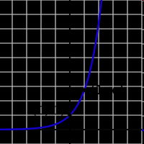

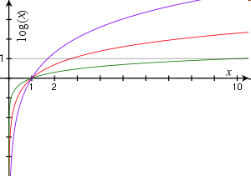

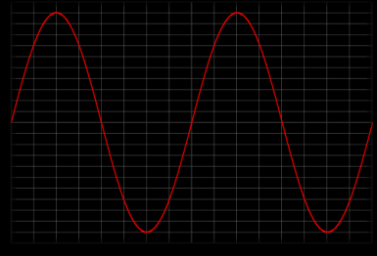


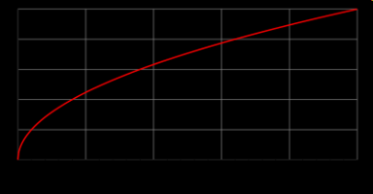
Functions
domain = R
codomain = R⁺-{0}
domain = R⁺-{0}
codomain = R
domain = R
codomain = [0,1]
domain = R⁺
codomain = R⁺

Slide 5
Functions
f(string) = length(string)
domain = the set of all strings
codomain = non-negative integers
f(student-name) = student-ID
not a function,
since one input could have
more than one output
domain = positive integers
codomain = {T,F}
f(x) = is-prime(x)

Slide 6
Injections (One-to-One)
is an injection iff no two inputs have the same output.
f( ) =
A
B
|A| ≤ |B|

Slide 7
Surjections (Onto)
is a surjection iff every output is possible.
f( ) =
A
B
|A| ≥ |B|

Slide 8
Bijections
is a bijection iff it is surjection and injection.
f( ) =
A
B
|A| = |B|

Slide 9
In-Class Exercises
Function | Domain | Codomain | Injective? | Surjective? | Bijective?
f(x)=sin(x) | Real | Real
f(x)=2^{x} | Real | Positive real
f(x)=x² | Real | Non-negative real
Reverse string | Bit strings of length n | Bit strings of length n
No
No
No
Yes
Yes
Yes
No
Yes
No
Yes
Yes
Yes
Whether a function is injective, surjective, bijective
depends on its domain and the codomain.

Slide 10
Inverse Sets
A
B
Given an element y in B, the inverse set of y := f⁻¹(y) = {x in A | f(x) = y}.
In words, this is the set of inputs that are mapped to y.
More generally, for a subset Y of B,
the inverse set of Y := f⁻¹(Y) = {x in A | f(x) in Y}.

Slide 11
Inverse Function
Informally, an inverse function f⁻¹ is to “undo” the operation of function f.
exactly one arrow in
f( ) =
A
B
There is an inverse function f⁻¹ for f if and only if f is a bijection.

Slide 12
Composition of Functions
Two functions f:X->Y’, g:Y->Z so that Y’ is a subset of Y,
then the composition of f and g is the function g。f: X->Z, where
g。f(x) = g(f(x)).
f
Y’
g
X
Z
Y

Slide 13
In-Class Exercises
Function f | Function g | g。f injective? | g。f surjective? | g。f bijective?
f:X->Y f surjective | g:Y->Z g injective
f:X->Y f surjective | g:Y->Z g surjective
f:X->Y f injective | g:Y->Z g surjective
f:X->Y f bijective | g:Y->Z g bijective
f:X->Y | f⁻¹:Y->X
No
No
No
No
Yes
No
No
No
No
Yes
Yes
Yes
Yes
Yes
Yes

